Slide 1
Front Page Giving
Making donation easier

Slide 2
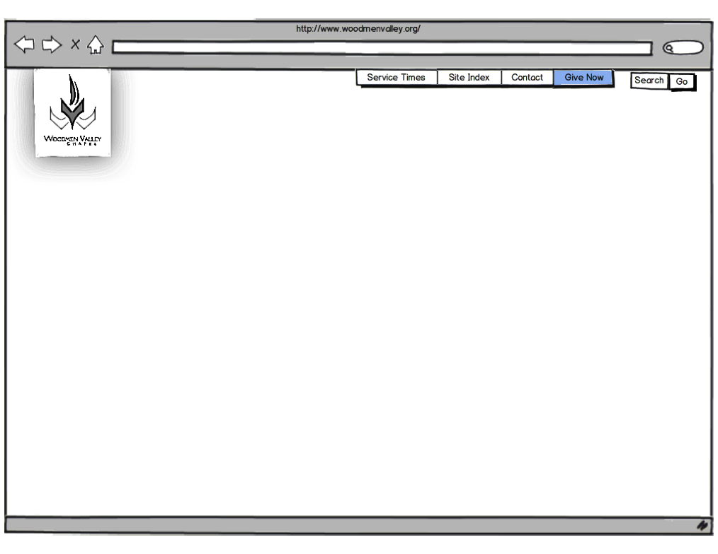
Home Page – Step 1
Home page will have an added button for give now
When “Give Now” is clicked the top slider will activate
This functionality should be available on all pages in the site

Slide 3
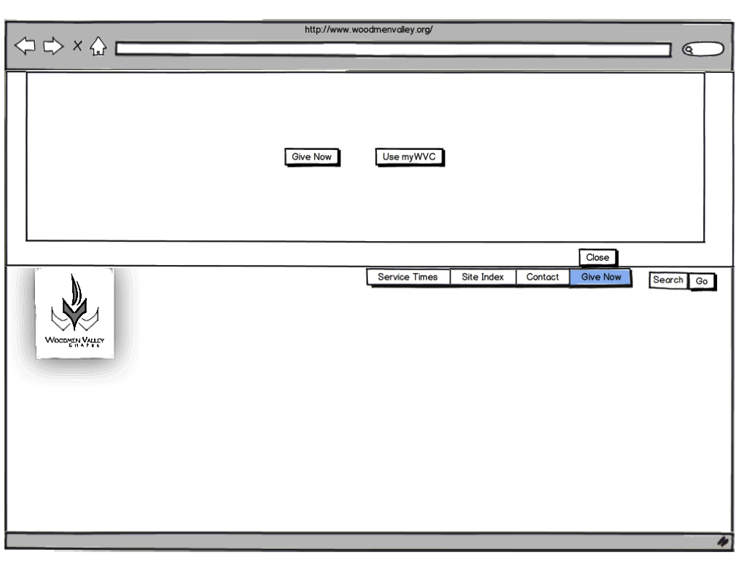
Login or Give Now – Step 2
Top Slider will have an iframe which will call an arena page that has the form elements and functionality on it. This page will be called securely (HTTPS).
The first panel will give two options: Give Now, or Login to myWVC, the Arena Portal
The close button will rehide the expandable div.

Slide 4
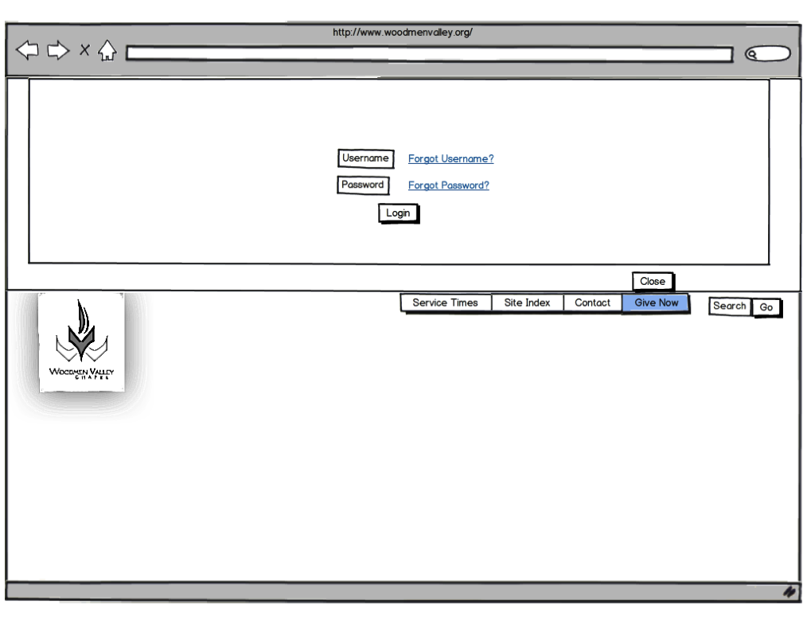
Login Selection – Step 2a
If “Use myWVC” is clicked then a login screen will be displayed using JS.
The username and password fields should be posted against the Arena login process
Close functions as described previously

Slide 5
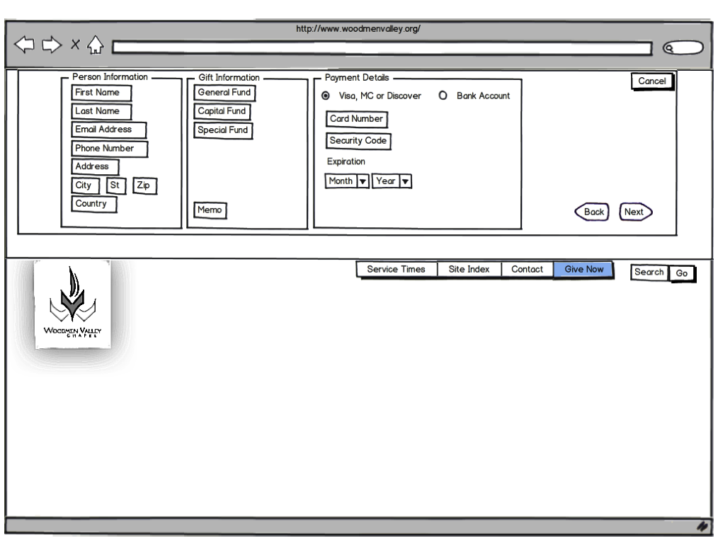
Contribution Information Credit Card – Step 3
If the user selects “Give Now” a form should be presented via JS
The close button is hidden to prevent closing with this information displayed
A cancel button is added which, if clicked, will clear the form data, clear the wizard state and close the expandable div
The Back button will return the user to the Give Now or Use myWVC option

Slide 6
Contribution Information Credit Card – Step 3 (cont.)
The “Next” button will advance the wizard to the confirmation page.
No Arena processing will occur until the user confirms the contribution

Slide 7
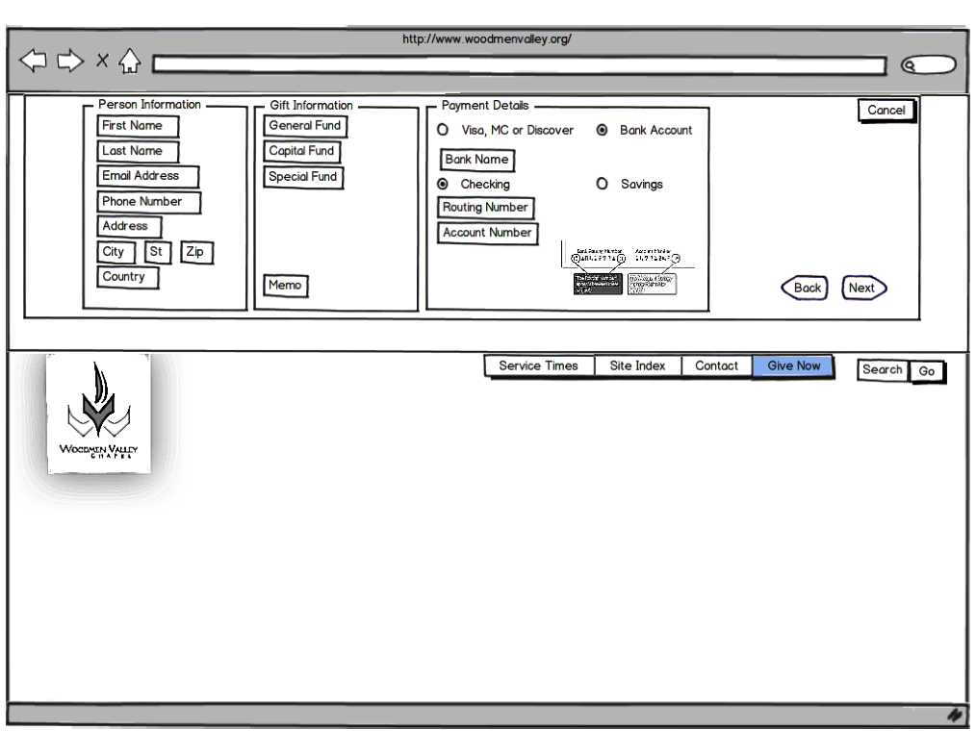
Contribution Information Bank Account – Step 3a
This is an alternate view if the user selects “Bank Account” under the Payment Details section
The “Checking” and “Savings” radio buttons do not cause any changes to the form

Slide 8
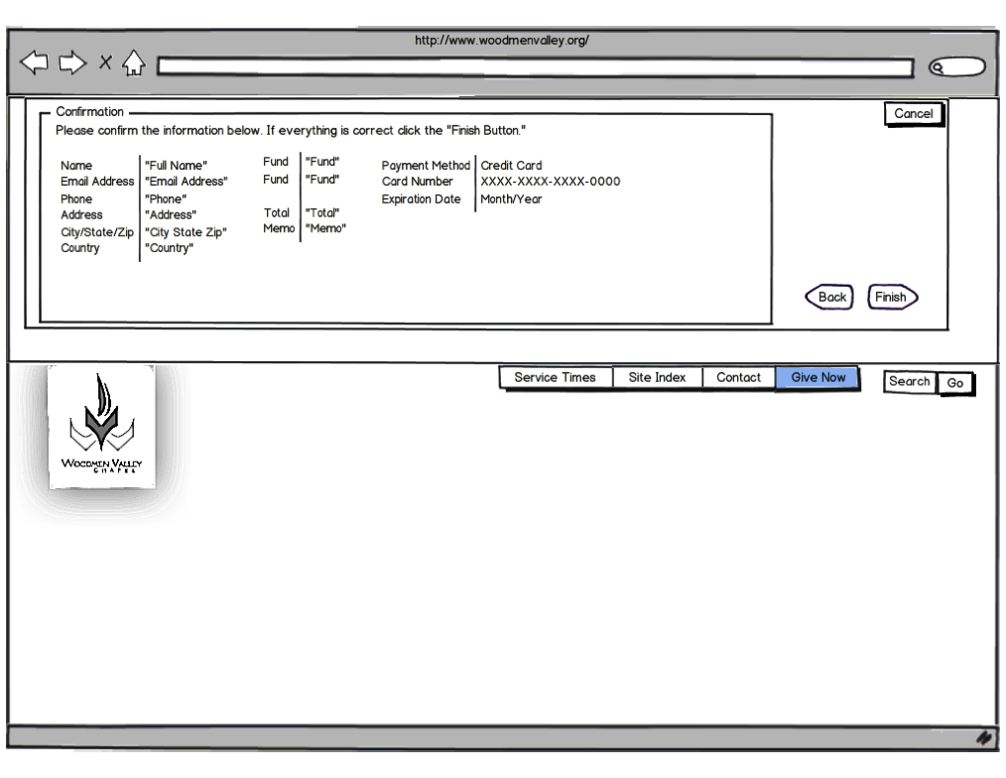
Contribution Confirmation Credit Card – Step 4
This panel should display the information from the information collection screen
When “Finish” is clicked the following processing should happen in Arena:
Create a new Person in Arena
Use the Person ID to record the contribution
Set the Member Status based on a module setting

Slide 9
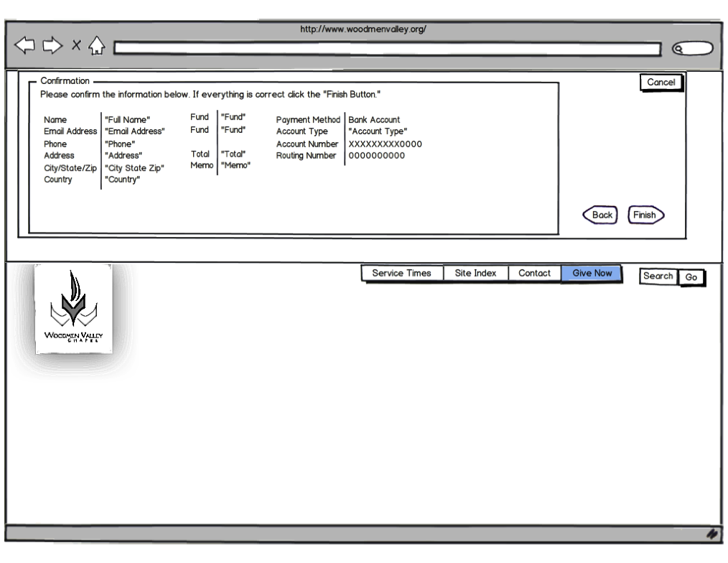
Contribution Confirmation Credit Card – Step 4a
This is alternate display in the event the user is confirming a Bank Account contribution

Slide 10
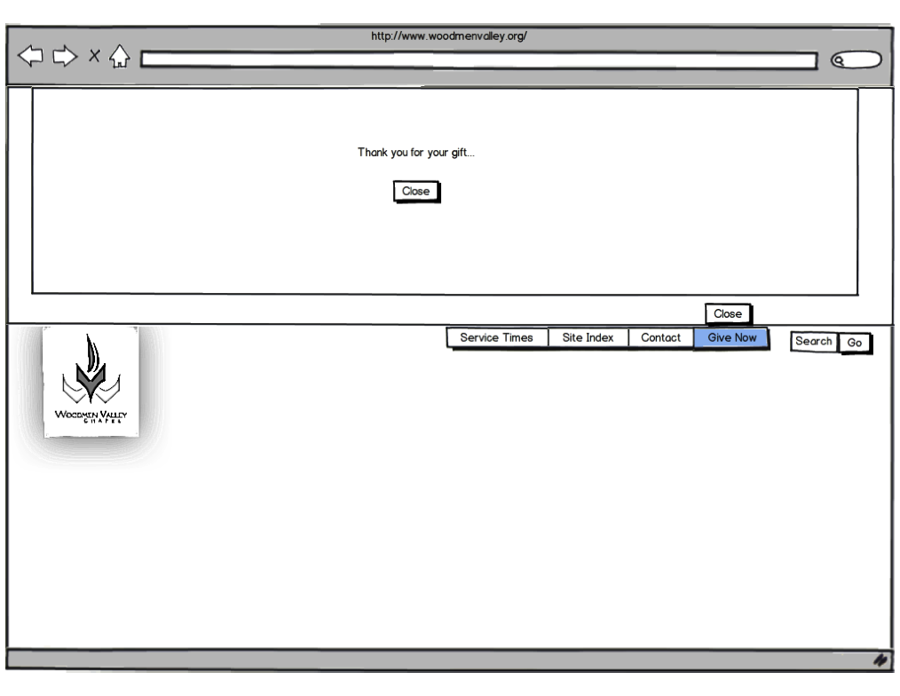
Thank You – Step 5
This is the thank you page that just has a close button that collapses the expandable div.

Slide 11
Module Settings
Member Status
ACH Gateway
CC Gateway
Cancel Page
Fund List
Maximum Giving Amount
Minimum Giving Amount
Validate Card Boolean

